Slide 1
How to get library eBooks on a Nook HD
Step-by-Step Guide
Prepared by the Computer Lab
Montgomery County-Norristown Public Library
October 2014

Slide 2
Be aware that OverDrive 3.2 requires the latest system updates to your Nook HD device before you can download it. Your device should update automatically after you connect to a WiFi hotspot. More information about updates can be found on the Barnes & Noble website under Support. If you do not have the latest updates, you will still be able to get OverDrive, but it will be version 2.2 and will function differently than in this tutorial

Slide 3
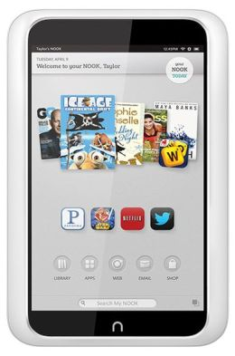
What is the process?
Overview of Basic Steps:
Connect your Nook HD to a WiFi hotspot to download the OverDrive App.
Sign up for an OverDrive account.
Use the OverDrive app to search library digital collection and check out a book.
Use the OverDrive app to read and manage your EPUB books.

Slide 4
What do I need to get started?
You will need:
a library card based on a residency in Montgomery County
Wireless access to the internet
A credit card (if this is your first time downloading an app on your Nook HD)
A valid email address to sign up for an OverDrive account
Your Nook HD

Slide 5
Policies and tips to bear in mind when borrowing eBooks…
Valid Montgomery County library card
Borrowing period- 7, 14 or 21 days
Borrowing limits-10 items at one time (audio and eBooks combined)
Renewable –There is a renew feature which allows you to place advance holds on titles that you currently have checked out. This feature is available three days prior to expiration of your title. You need to do this proactively. You will not be prompted.
Reserving – limited to 10 items at one time (audio and eBooks combined)
Pick up a reserve book within 72 hours of email notification
Late Fees – None!
“Shopping” cart – lasts only 30 minutes!

Slide 6
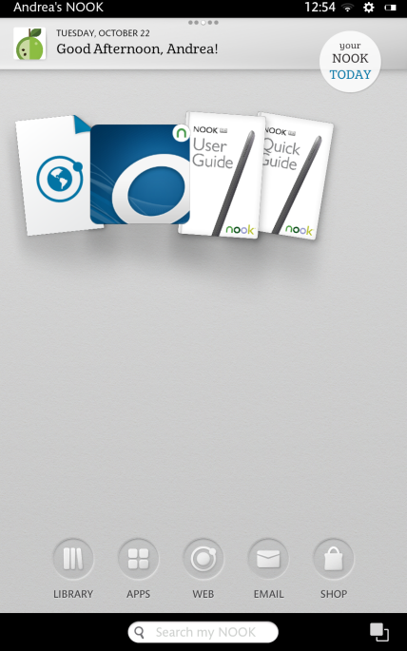
Getting the OverDrive app
From your Home screen TAP on the APPS button

Slide 7
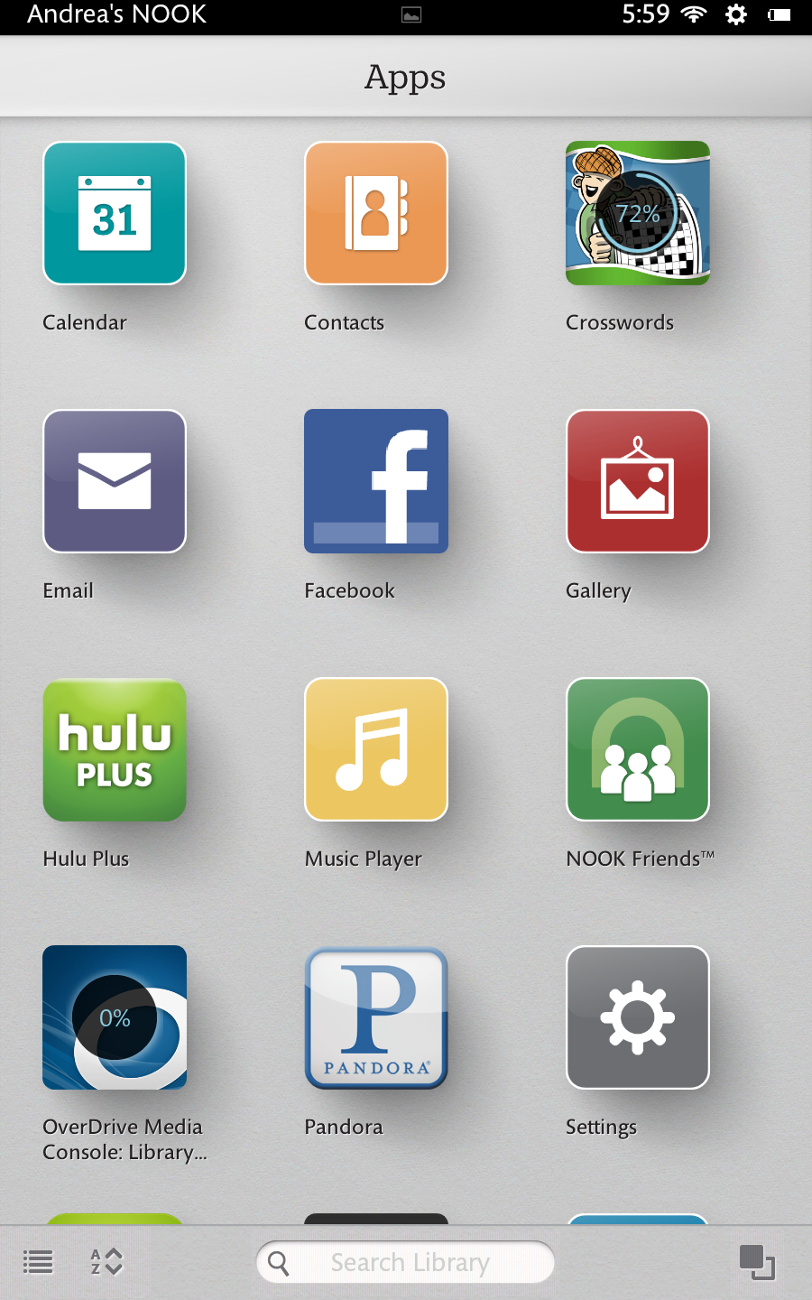
Getting the OverDrive app
You may see that the “OverDrive” app is already in your apps directory. While this may have been included by default with your device, it still needs to be downloaded. Tap on the OverDrive icon to begin downloading the app. If you cannot locate the app, proceed to the next slide to “shop” for it.

Slide 8
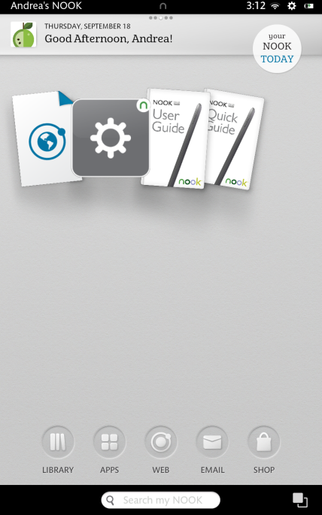
Getting the OverDrive app
First, get to your Home screen by pressing the home button, the physical button on your device. Then tap the SHOP button.

Slide 9
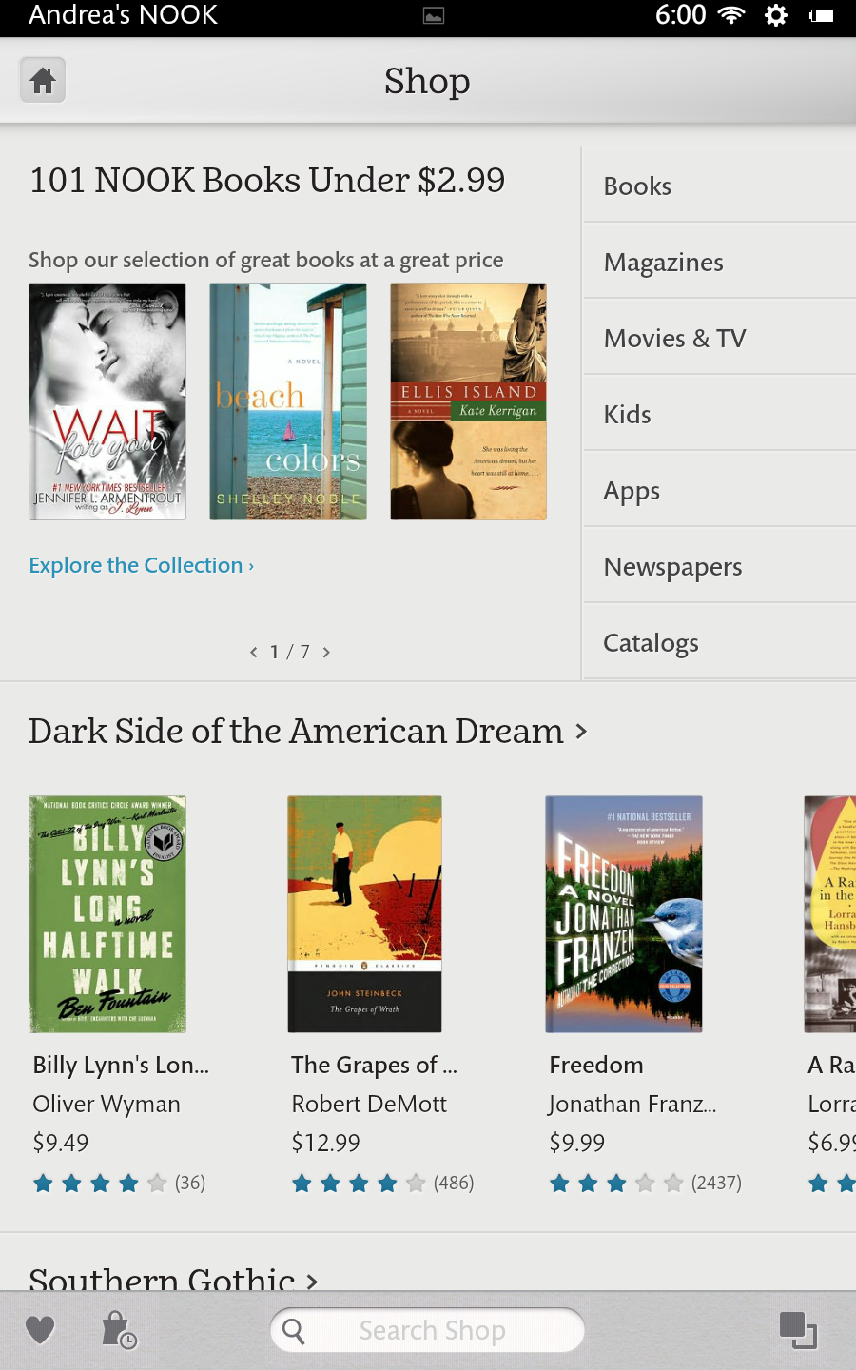
Getting the OverDrive app
This is the B&N shop store. Tap on the search field at the bottom center. It has a magnifying glass to the left of the space. Type in “OverDrive”.

Slide 10
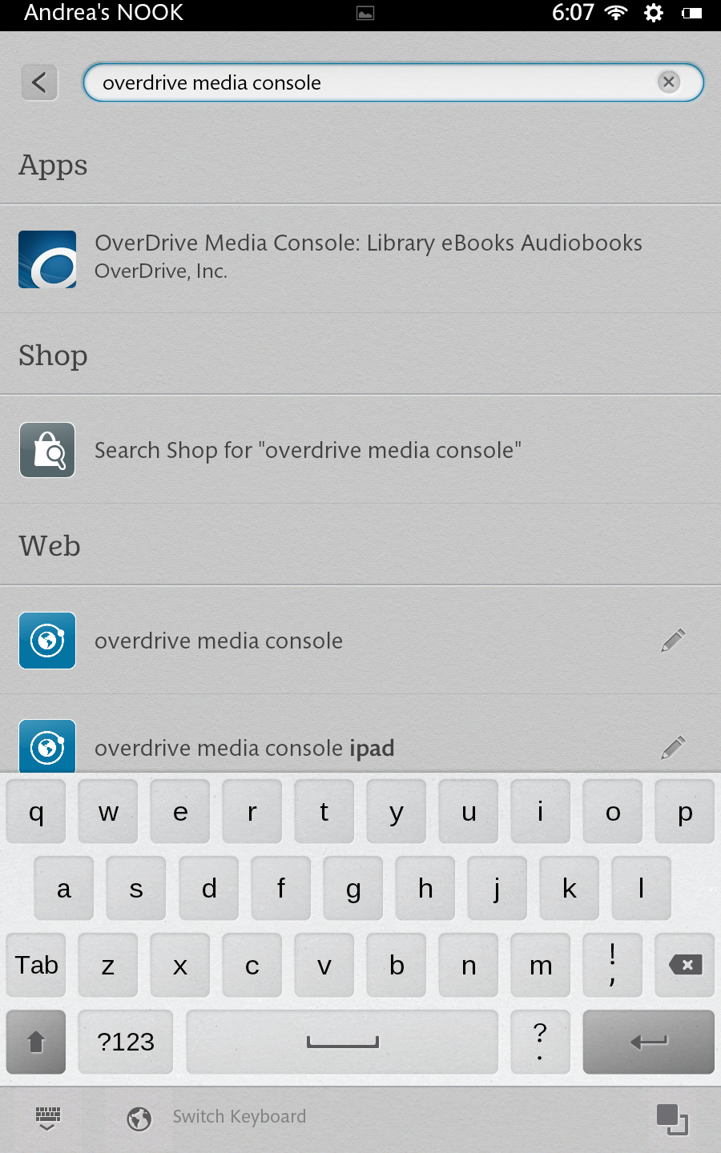
Getting the OverDrive app
The app appears in the suggested list as soon as you type in OverDrive, then you can tap on the selection. If it does not show, you can tap the enter button to produce a list of matching search results.

Slide 11
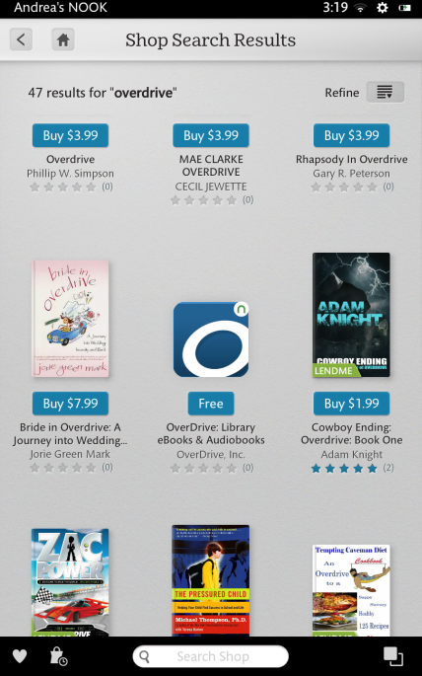
Getting the OverDrive app
In the search results, the app should be listed somewhere on the page. If it is hard to find, you can limit the search to only apps by tapping on the “Refine” button in the upper left.

Slide 12
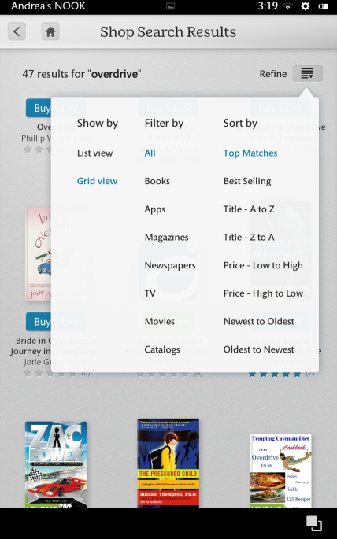
Getting the OverDrive app
Now tap on “Apps”.

Slide 13
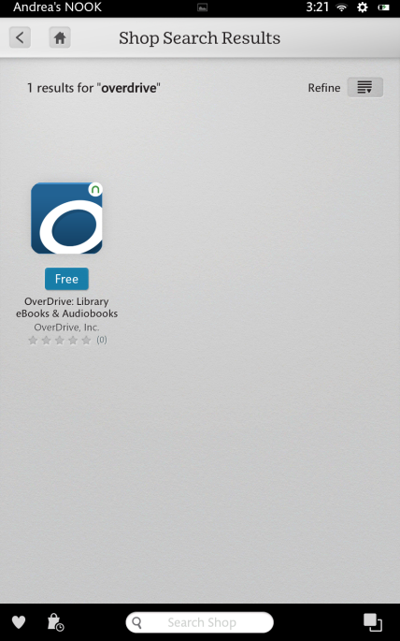
Getting the OverDrive app
This should show only the OverDrive app. Tap on it to bring you to the details page.

Slide 14
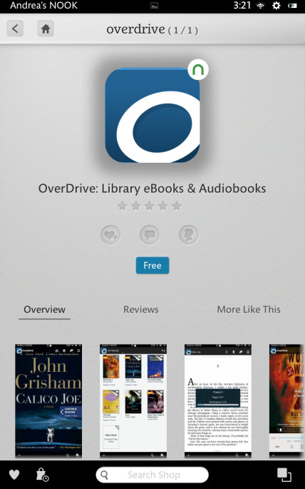
Getting the OverDrive app
This is the apps information page. You can scroll down to see more information about the app.

Slide 15
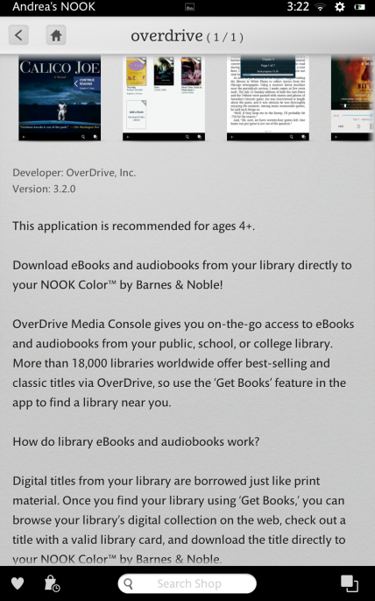
Getting the OverDrive app
As mentioned earlier, if your device has the latest system updates, then a version number starting with a 3 should be shown.
If a version starting with a 2 is shown, then you need to download the latest system updates for your device before you can continue. Please refer to the B&N website for more details on how to update.
Now scroll back up and tap “Free”.

Slide 16
Getting the OverDrive app
Then tap Confirm.

Slide 17
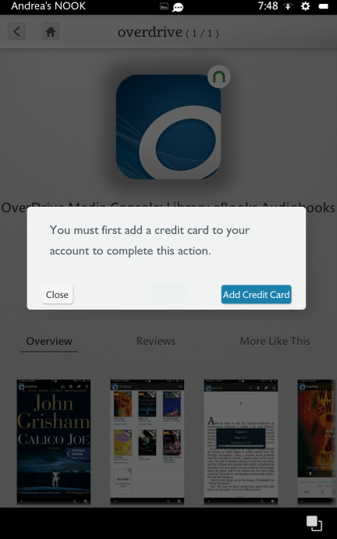
Getting the OverDrive app
If this is the first time you are downloading an app from the store, you will be asked to enter your credit card. This is required by Barnes & Noble and necessary whether or not the app you want to download is free.
After you do this, you will not be charged for the OverDrive app.

Slide 18
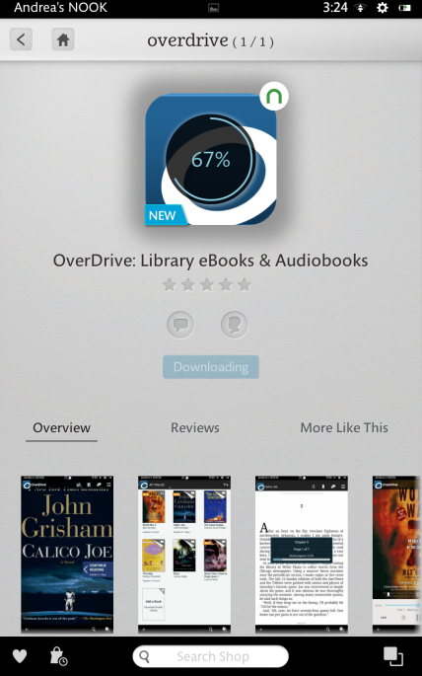
Getting the OverDrive app
The app begins downloading.

Slide 19
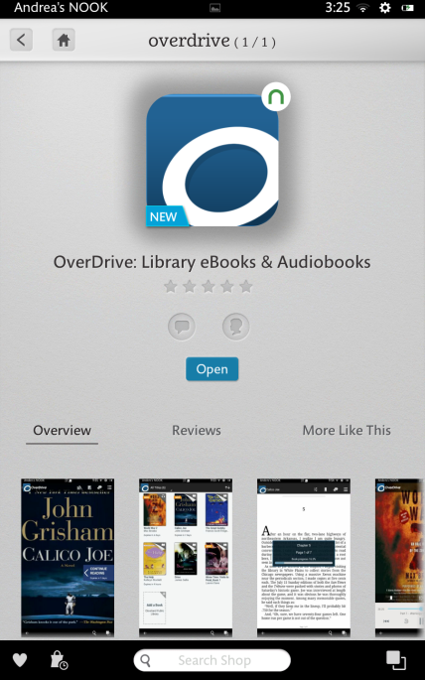
Getting the OverDrive app
Once downloaded and installed, an open button will appear. Tap Open to continue.
If you need to open the app later, the app should appear in the carousel on your device’s homescreen. If not, you can find it by searching in your apps directory as described before.

Slide 20
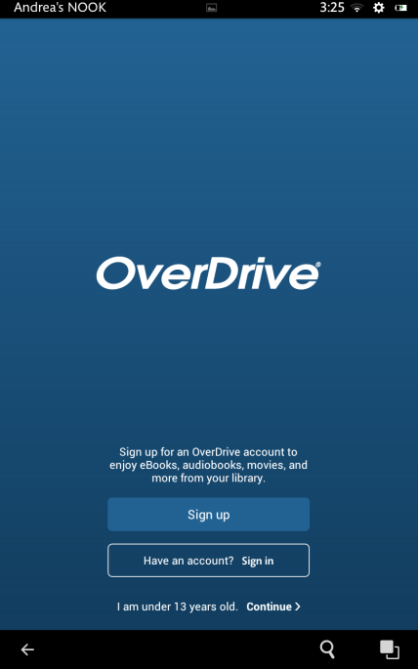
Using the OverDrive app
When you first open the app, you will be asked to either sign up for an Overdrive account, or login with a current one. If you are using this app for the first time, tap on the “Sign up” button.

Slide 21
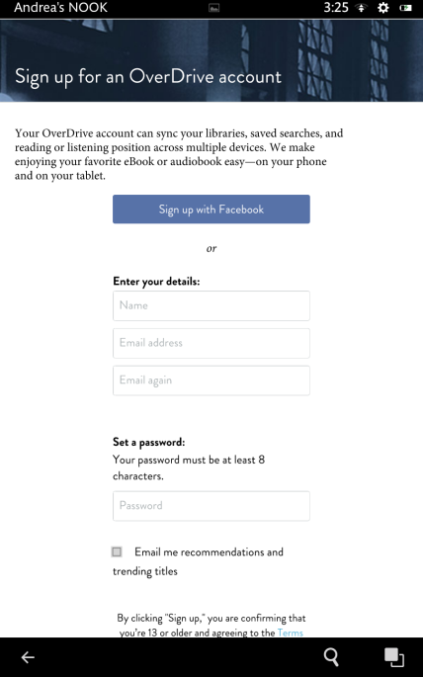
Using the OverDrive app
If you have a Facebook account, you can easily use that to sign up with OverDrive. It will automatically link with Facebook so you can use your same login credentials.
Otherwise you can sign up by entering your email address and a password.

Slide 22
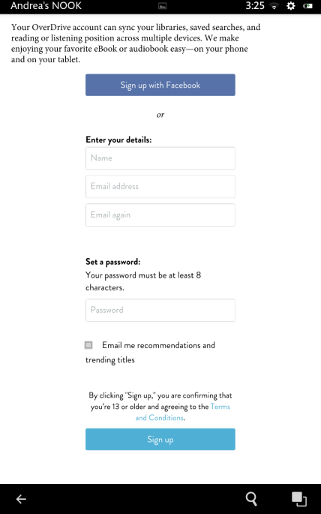
Using the OverDrive app
As of this writing, there is only one password field, so make sure you take your time and enter your password correctly. After you are done, tap the “Sign up” button.

Slide 23
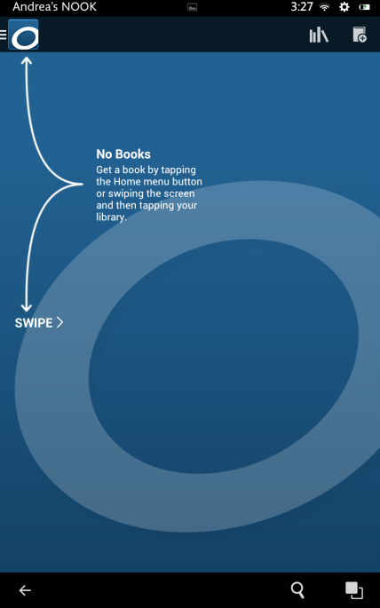
Using the OverDrive app
When you first open the app a screen of usage tips may appear.
After you download some books, your most recently viewed book will appear on this screen.
Tap or slide to get to the menu.

Slide 24
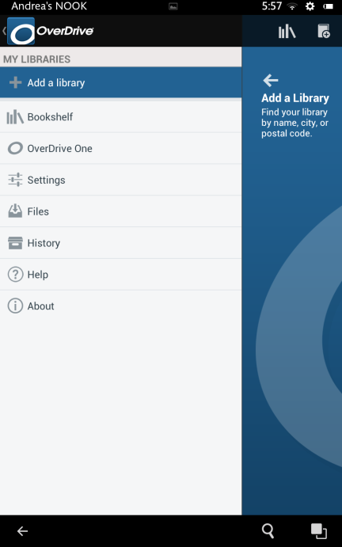
Using the OverDrive app
Tap the Add a Library button.

Slide 25
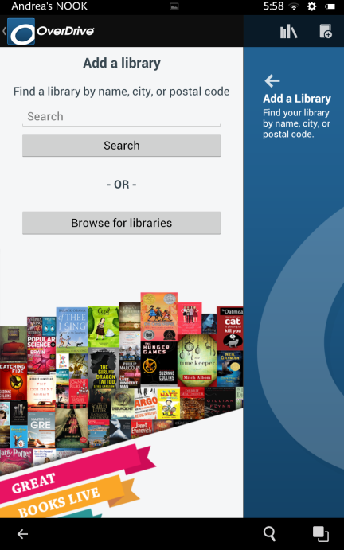
Using the OverDrive app
On the Add a Library screen there is a Search box where you should type in the name of the town where your Montgomery County home library is.

Slide 26
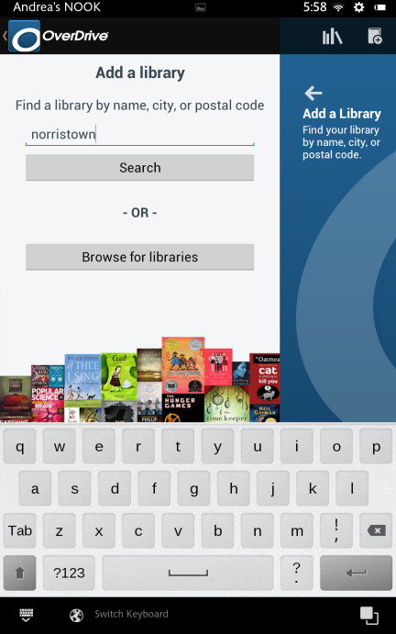
Using the OverDrive app
Our library is in Norristown.

Slide 27
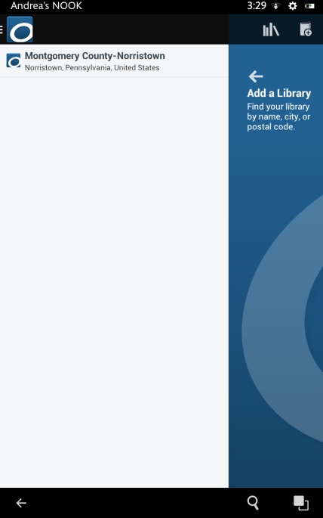
Using the OverDrive app
A list of libraries in and near your town may display.
Scroll or swipe until you see your library. Then tap on it.
Ours was the only one on the list because it’s the only library in Norristown.

Slide 28
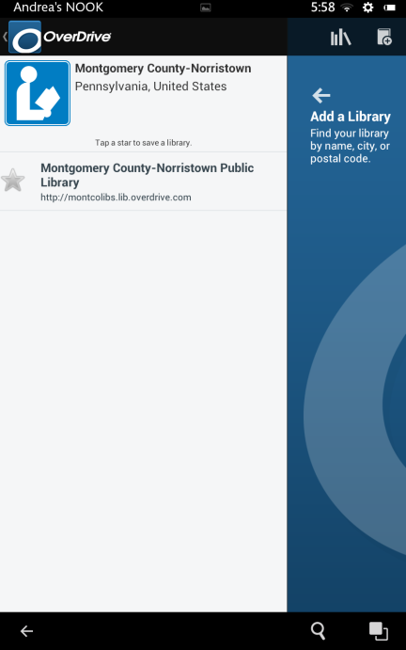
Using the OverDrive app
Now tap the grey star.

Slide 29
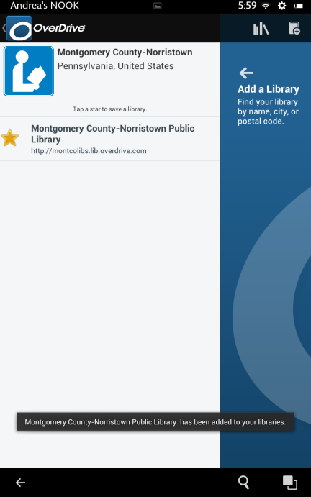
Using the OverDrive app
The grey star turns gold and now our library is added to our “Get Books” list. Tap on the library name to start looking for a book.

Slide 30
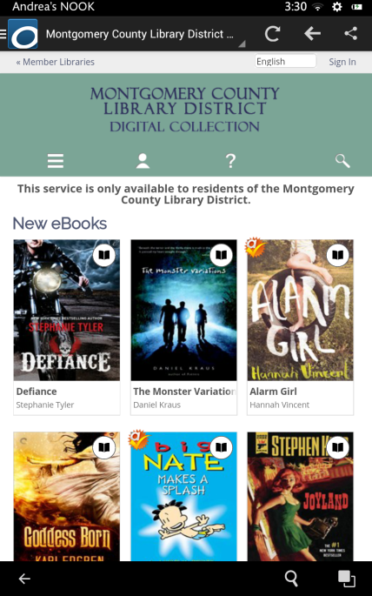
Using the OverDrive app
This is our library’s OverDrive website where we can search for eBooks in the digital collection for the Montgomery County Library District.
Tap on the Menu button.

Slide 31
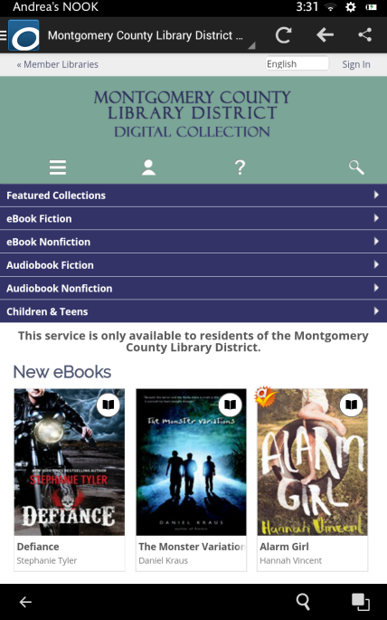
Using the OverDrive app
This is the main menu.
Tap on eBook Fiction.

Slide 32
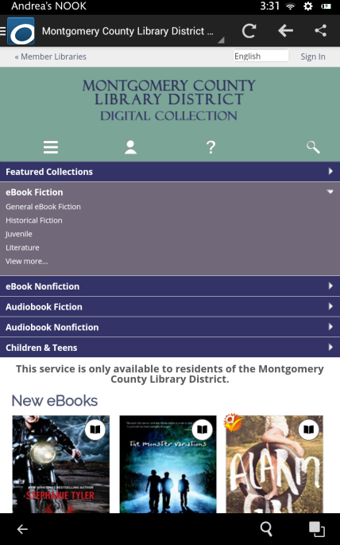
Using the OverDrive app
This is the eBook Fiction submenu.
Tap on Historical Fiction.

Slide 33
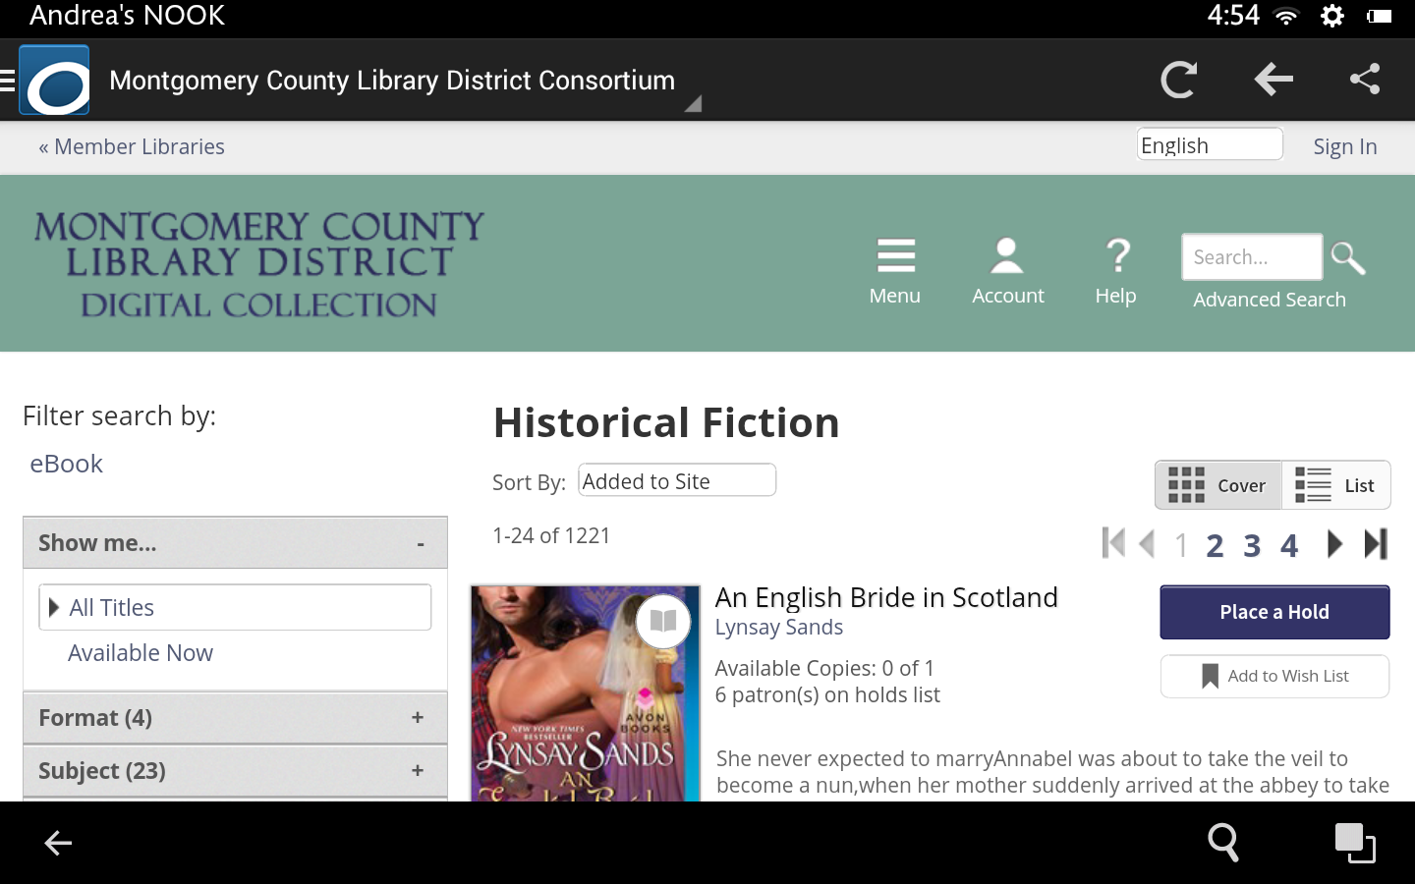
Using the OverDrive app
This is how the Historical Fiction collection displays in landscape mode. Note the side menu with filtering and search options.

Slide 34
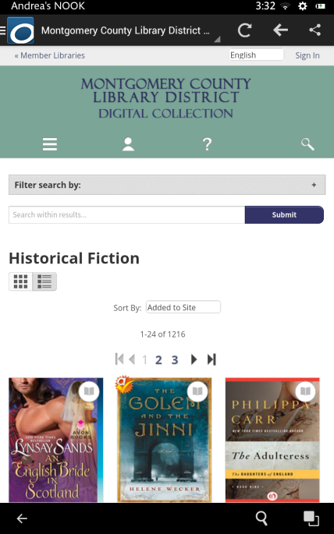
Using the OverDrive app
In portrait mode, the filter options condense. You will need to tap on the “Filter search by:” button to expand the options.

Slide 35
Using the OverDrive app
We will remain in portrait mode to search for a book by author Stephen King.
Tap Montgomery County Library District to return to the home page.
We recommend that before you begin searching for material that you sign-in to your OverDrive account. You will need to know which library your library card is registered at and you’ll need your library card. Tap Sign-In.

Slide 36
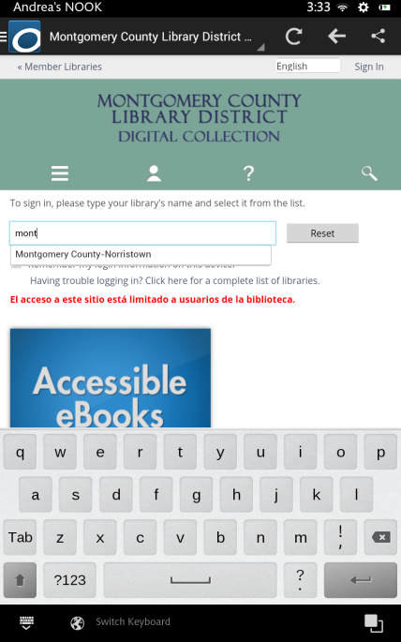
Using the OverDrive app
In the empty field, begin typing in the name of your library, which in our case is Montgomery.
As soon as you begin typing, you should see a list of possible matches. Tap on your library name.

Slide 37
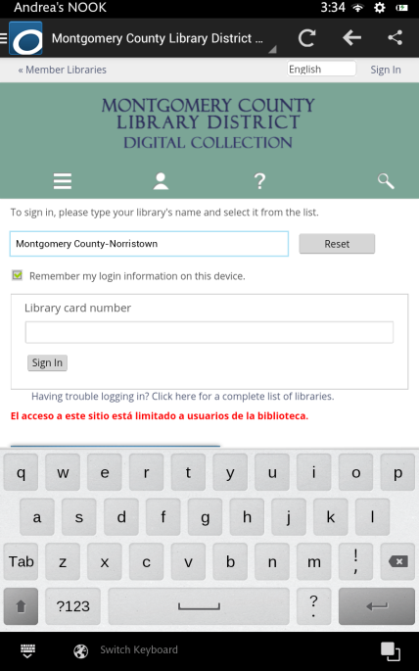
Using the OverDrive app
You can put a checkmark in the box next to “remember my login information on this device”.

Slide 38
Using the OverDrive app
Next, enter your library card number and then tap Sign in.

Slide 39
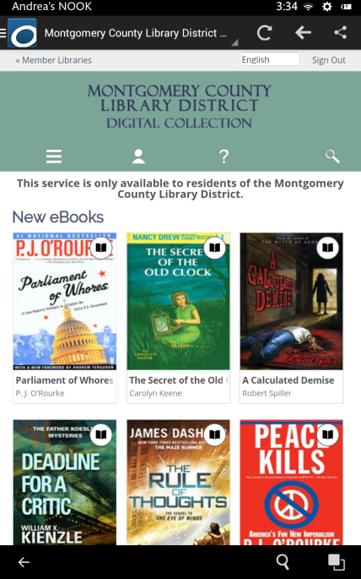
Using the OverDrive app
You should now be on the OverDrive home screen. Tap the search button.

Slide 40
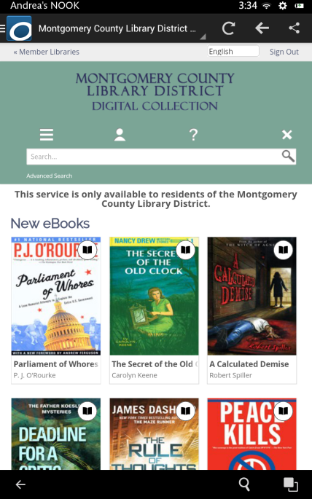
Using the OverDrive app
Tap the Advanced Search link.

Slide 41
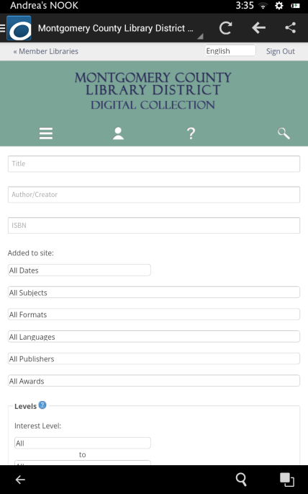
Using the OverDrive app
Enter Stephen King into the Author/Creator field.
Next we are going to make sure we are searching for the EPUB eBook format. Tap All Formats.

Slide 42
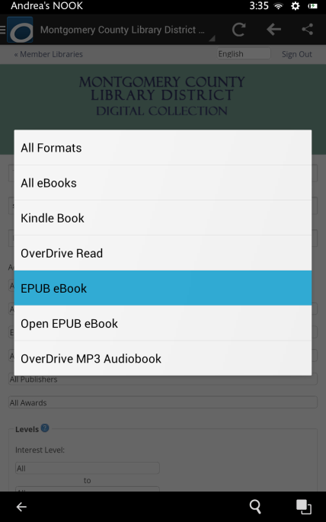
Using the OverDrive app
Tap on the EPUB eBook format.

Slide 43
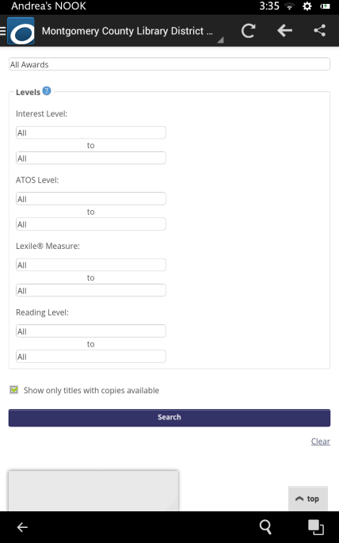
Using the OverDrive app
Finally, put a checkmark in the box that says “Show only titles with copies available.” That way we know that the book we find can be checked out right away. Then tap “Search.”

Slide 44
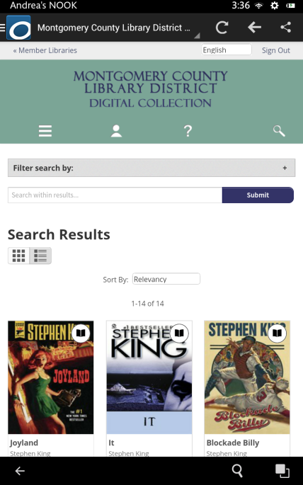
Using the OverDrive app
The Search results can be viewed in two different ways.
The Cover view shows only the Covers of books along with their title and author.

Slide 45
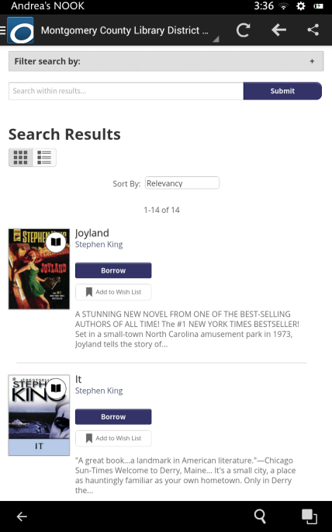
Using the OverDrive app
The List view gives you slightly different information and includes a Borrow button.
However, if you use the Borrow button, you won’t be able to choose a lending period. In order to choose a lending period you need to tap on the book cover.

Slide 46
Using the OverDrive app
Back in the Cover view, we are scrolling through the results list and we decide to borrow Blockade Billy.
Tap on the cover of the book.

Slide 47
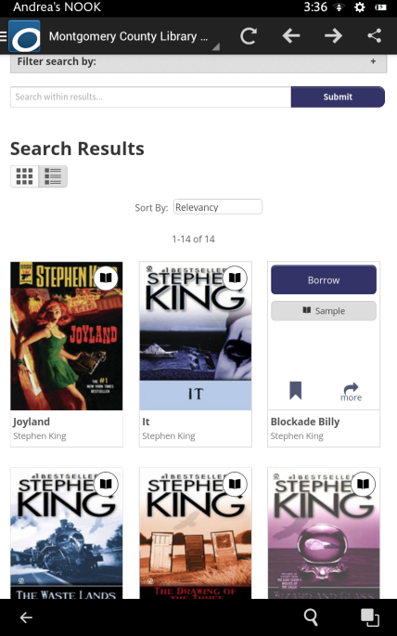
Using the OverDrive app
After you tap the cover, there are some quick options you can perform on the book. We want to see the page with all of the information pertaining to the book, so tap on the “more” button.

Slide 48
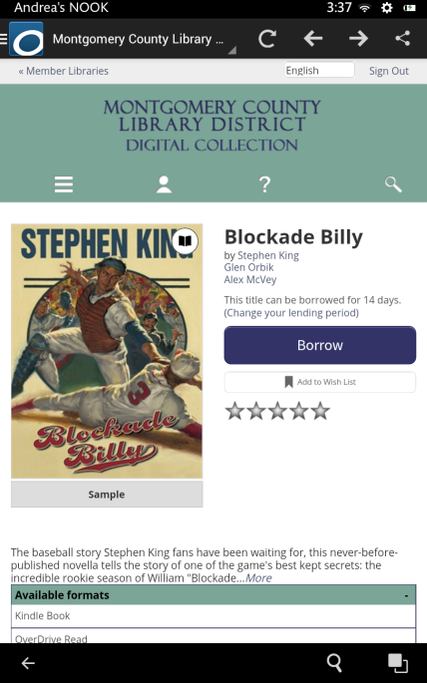
Using the OverDrive app
Note the Borrow button and the message underneath that says the title can be borrowed for 14 days.
This loan period draws from a setting in your account that applies to all digital loans.
The following screens show how to change this setting if you want the book for less or more time. We’ll start by tapping on “Change your lending period”.

Slide 49
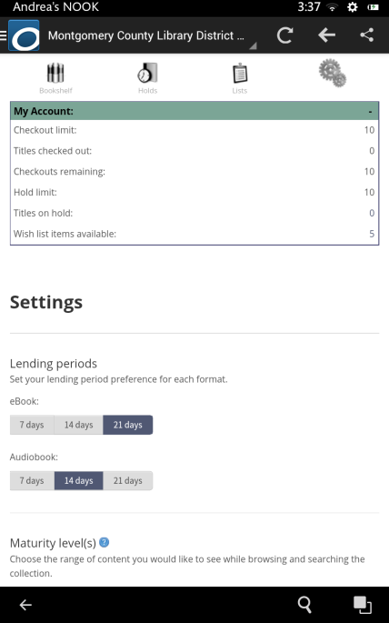
Using the OverDrive app
This screen is the account settings. Tap on the desired lending period for your eBooks. We’re going to change ours to 21 days.
Now tap the back button ONCE. Make sure to wait until the page loads. Tapping the back button twice exits the app, and you may have to start over again to get your book.

Slide 50
Using the OverDrive app
Back at the book, notice how the loan period has changed.
Be aware that the lending period will now be 21 days for every future book we borrow until we change the lending period again in our account settings.
Now tap the Borrow button.

Slide 51
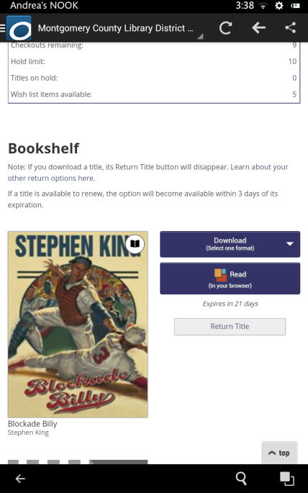
Using the OverDrive app
Once the book has been borrowed you will be brought to your OverDrive bookshelf where you will find the Download button.
Take note that in case you don’t want to keep this book after all, you have an opportunity to return the book directly from this page before you download it (see Return Title button). Once you download the book, you will only be able to return the book from within the app.

Slide 52
Using the OverDrive app
Notice that the Download button says that we need to pick a format. Tap the Download button.

Slide 53
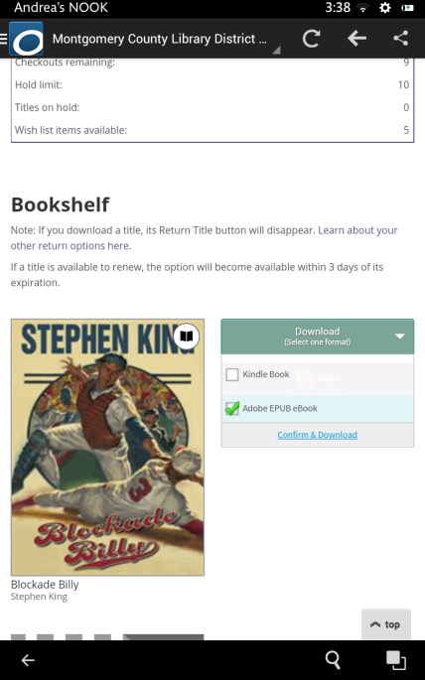
Using the OverDrive app
Make sure to select Adobe EPUB eBook. Once the format is selected from the drop-down menu, you would then click the Confirm & Download link. Bear in mind that once you click the Confirm & Download link, you will not have a chance to change the format. You will also only be able to return the book from the OverDrive app controls.

Slide 54
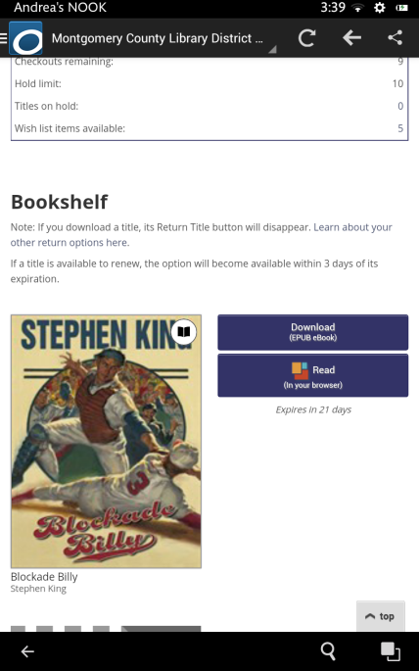
Using the OverDrive app
The download button for Blockade Billy shows that the EPUB format was selected and the lack of a Return Title button indicates it has already been downloaded.
The download button remains on your online bookshelf because you can download your book up to three times to different devices that have the same OverDrive account.
Now tap on the main menu button in the upper left.

Slide 55
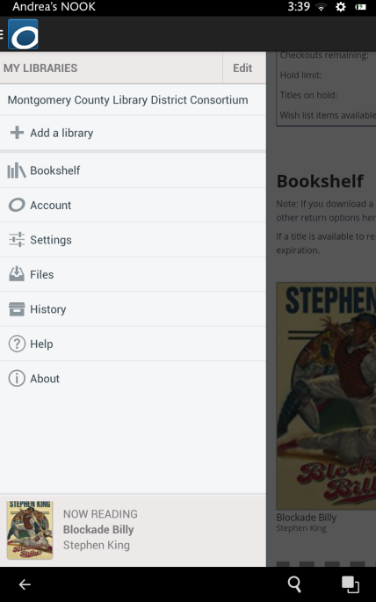
Using the OverDrive app
then tap Bookshelf.

Slide 56
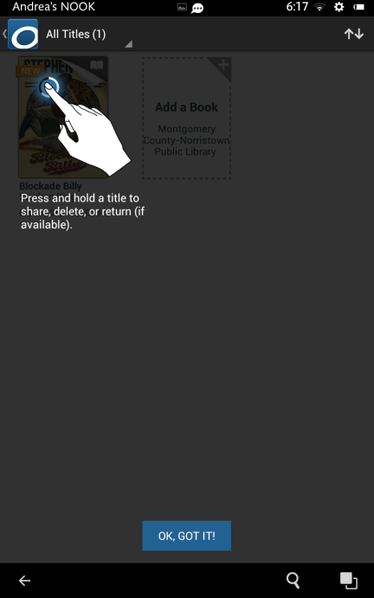
Using the OverDrive app
When you first go to your bookshelf, a prompt will come up showing how to return books.
Just tap the “OK, GOT IT!” button to continue.

Slide 57
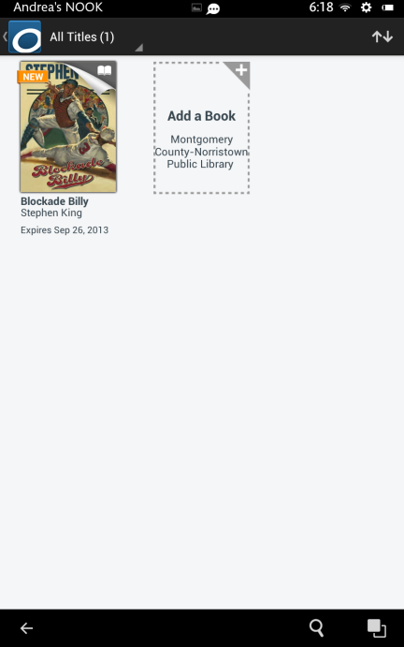
Using the OverDrive app
On your Bookshelf, you can tap on the book jacket to open it.

Slide 58
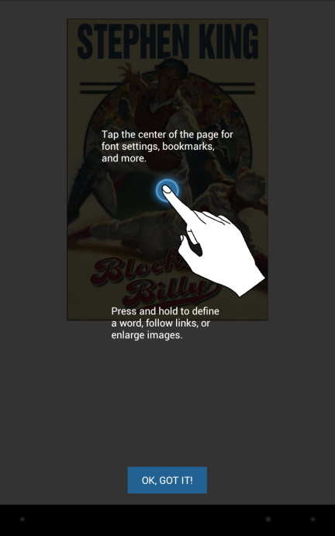
Using the OverDrive app
A prompt may come up explaining how to read books in the OverDrive app.
Tap the “OK, GOT IT!” button to continue.

Slide 59
Using the OverDrive app
This is the cover of the book. Swipe to navigate through pages.

Slide 60
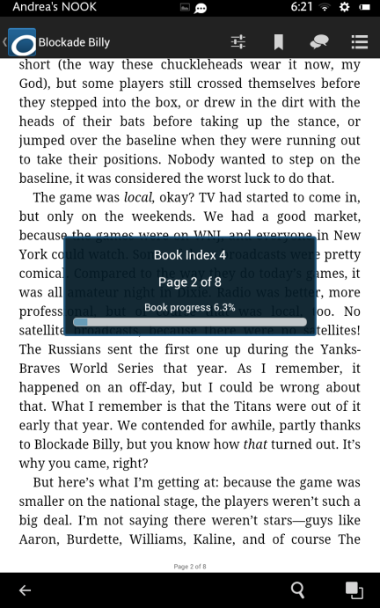
Using the OverDrive app
As you read your book there are certain controls available to you.
To view the controls tap once in the middle of the page.
Let’s look at some of those controls. Tap the Navigation button (circled).

Slide 61
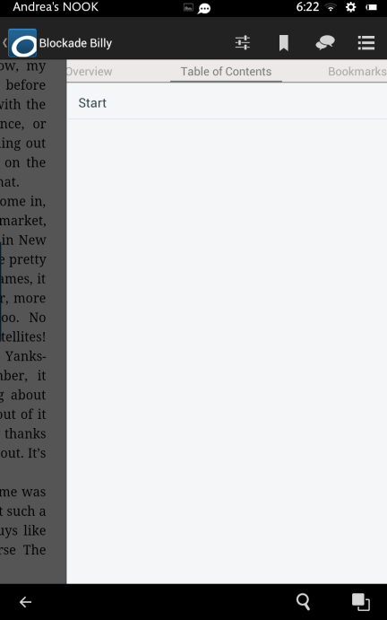
Using the OverDrive app
A display will show your chapter navigation. Note that not all books will be encoded with a table of contents, and you will still need to swipe to navigate through the book.
Tap the Settings button.

Slide 62
Using the OverDrive app
The settings menu is shown here with choices to improve or enhance your reading experience.

Slide 63
Using the OverDrive app
Tap the Bookmark button.
Bookmarking is not meant for saving your place in the book; that happens automatically when you stop reading. Bookmarking saves pages for you that you might want to read again.

Slide 64
Using the OverDrive app
Tap the Share button.
The OverDrive app allows you to participate with your social media accounts directly to share what you are reading with others.

Slide 65
Using the OverDrive app
To return to your bookshelf, tap on the Menu button, then tap on Bookshelf from within the menu.

Slide 66
Using the OverDrive app
To return your book, tap and hold on the book that you want to return.

Slide 67
Using the OverDrive app
A prompt will appear. Tap on the Return button.
It makes sense to Return instead of simply deleting. If you don’t return it, it is still checked out to you until the loan expires and nobody else can get it.

Slide 68
Using the OverDrive app
Tap Yes to confirm. This will return the book to the library, increasing books you can borrow on your account by one, and also deletes it from your device, freeing up space.

Slide 69
Using the OverDrive app
Our bookshelf is now empty.
To borrow another book, just tap the “Add a Book” button and it will automatically open your library’s OverDrive website again so you can search for another book.

